Slide 1
Reference Type & Variable
Object Oriented Programming
Lecture # 8
Prepared by: Mehak Usmani

Slide 2
Content
Reference Type & Reference Variable
Primitive Types vs. Reference Types Variables
Java classes
Instance Variables and Methods
Static Variables and Methods

Slide 3
Reference Variables and Reference Types
Simply, reference variable is an object and reference type is a class.
Objects are accessed via object’s reference variables, which contain references to the objects.
A class is a reference type, which means that a variable of the class type can reference an instance of the class.
The following statement declares the variable myCircle to be of the Circle type: Circle myCircle;
The next statement creates an object and assigns its reference to myCircle: myCircle = new Circle();
a single statement can combines the declaration of reference variable, the creation of an object, and the assigning of an object reference as; Circle myCircle = new Circle();

Slide 4
Heap & Stack Memory
Java Heap space is used by java runtime to allocate memory to Objects and JRE classes.
Objects are created in heap memory but method frames are stored in Stack memory.
Garbage Collection runs on the heap memory.
Stack contains method specific values and references that are short-lived. Stack implements LIFO.
Heap memory is shared by all threads of Java application but Stack memory is local to each thread.
Size of heap space is much bigger than the small size of Stack in Java

Slide 5
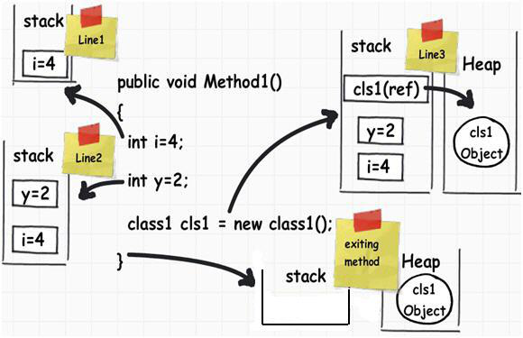
Heap & Stack Memory

Slide 6
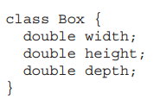

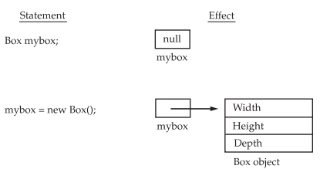
Reference Variables

Slide 7
Object or Reference variable
An object reference variable that appears to hold an object actually contains a reference to that object.
Strictly speaking, an object reference variable and an object are different, but most of the time the distinction can be ignored.
Therefore, for simplicity, myCircle can be called a Circle object rather than use the longer-winded description that myCircle is a variable that contains a reference to a Circle object.
When you assign one object reference variable to another object reference variable, you are not creating a copy of the object, you are only making a copy of the reference.

Slide 8

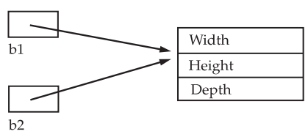
Object or Reference variable
Object reference variables act differently when an assignment takes place
Is b2 being assigned a reference to a copy of the object referred to by b1? No! After this statement, b1 and b2 will both refer to the same object. It will not allocate any memory or copy any part of the original object.
Any changes made to the object through b2 will affect the object to which b1 is referring, since they are the same object.
If b1 has been set to null, b2 will still points to the original object.

Slide 9
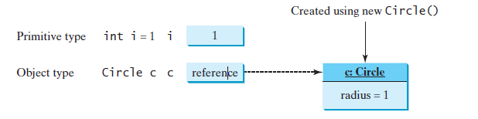
Variables of Primitive Types and Reference Types
Every variable represents a memory location that holds a value.
Declaring a variable is to tell the compiler what type of value the variable can hold.
For a variable of a primitive type, the value is of the primitive type.
For a variable of a reference type, the value is a reference to where an object is located.

Slide 10
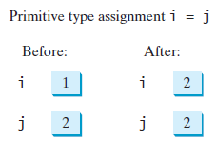
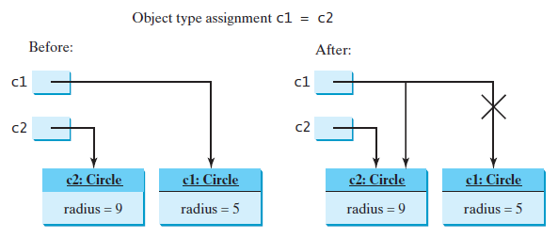
Variables of Primitive Types and Reference Types
When you assign one variable to another, the other variable is set to the same value.
For a variable of a primitive type, the real value of one variable is assigned to the other variable.
For a variable of a reference type, the reference of one variable is assigned to the other variable.

Slide 11
Garbage collection
The object previously referenced by c1 is no longer useful and therefore is now known as garbage.
Garbage occupies memory space, so the Java runtime system detects garbage and automatically reclaims the space it occupies. This process is called garbage collection.
If you know that an object is no longer needed, you can explicitly assign null to a reference variable for the object. The JVM will automatically collect the space if the object is not referenced by any variable.

Slide 12
null
If a data field of a reference type does not reference any object, the data field holds a special Java value, null.
null is a literal just like true and false. While true and false are Boolean literals, null is a literal for a reference type.
The default value of a data field is null for a reference type.
Java assigns no default value to a local variable inside a method.
public class Test {
public static void main(String[] args) {
int x; // x has no default value
System.out.println("x is " + x); // error
}
}

Slide 13
NullPointerException
NullPointerException is a common runtime error.
It occurs when you invoke a method on a reference variable with a null value.
Make sure you assign an object reference to the variable before invoking the method through the reference variable.

Slide 14
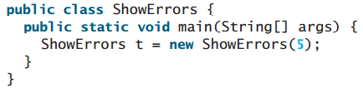
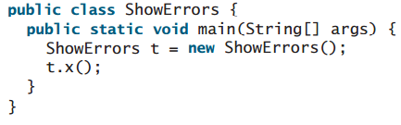
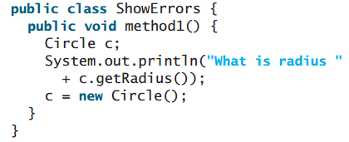
What is wrong with each of the following programs?

Slide 15
Using Classes from the Java Library
The Java API contains a rich set of classes for developing Java programs.
The Object class is the parent class of all the classes in java by default. It is the topmost class of java.
Different classes are frequently used by Java developers, some of which are;
The Date Class
The Random Class
The String Class
Boolean
Integer

Slide 16
The Date Class
Java provides a system-independent encapsulation of date and time in the java.util.Date class.
The no-arg constructor of the Date class can be used to create an instance for the current date and time.
Date date = new Date();
The getTime() method of Date class returns the elapsed time since January 1, 1970, GMT, and the toString() method return the date and time as a string.
The Date class has another constructor, Date(long elapseTime), which can be used to construct a Date object.
Notes:
Format the date:
SimpleDateFormat sdf = new SimpleDateFormat("dd/M/yyyy");
String date = sdf.format(new Date())

Slide 17
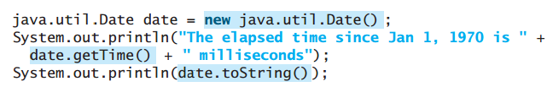
The Date Class
Output:

Slide 18
The Random Class
Just like random function of Math class, there is another class called Random Class that can be used to generate random numbers.
The class can generate a random int, long, double, float, and boolean value.
The random object can be created with no-arg as well as parameterized constructor.
The no-arg constructor creates a Random object using the current elapsed time as its seed.
Random object can be created by specifying a seed .
A seed is a number used to initialize a random number generator.
If two Random objects have the same seed, they will generate identical sequences of numbers.

Slide 19
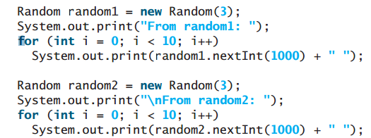
The Random Class
Output:

Slide 20
Instance Variables and Methods
The data field in the class is known as an instance variable.
The method defines in the class are instance method.
Instance variable or Instance method are dependent on a specific instance.
Instance variable or instance method are non-static that means it cannot be access with class name only.
It needs an object or instance to get accessed or invoked.
An instance variable is tied to a specific instance of the class; it is not shared among objects of the same class.

Slide 21
static Variables and Methods
A static variable is shared by all objects of the class. static int radius;
Static variables (also called class variable) store values for the variables in a common memory location. Because of this common location, if one object changes the value of a static variable, all objects of the same class are affected.
Static methods can be called without creating an instance of the class. static double getArea();
A static method cannot access instance members of the class.
Static members can be directly invoked by the class. Example: Math.pow(3, 2.5).
To declare a static variable or define a static method, put the modifier static in declaration.

Slide 22
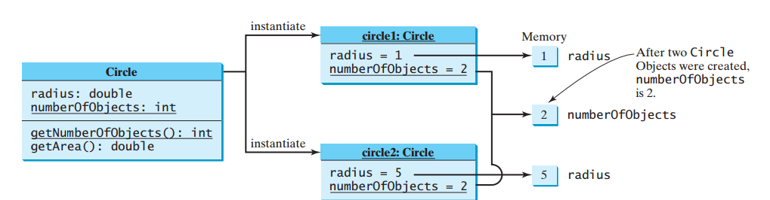
UML Notation
Instance variables belong to the instances and have memory storage independent of one another. Static variables are shared by all the instances of the same class.
static variables or methods are underlined in the UML diagram.

Slide 23
static Constants
Constants in a class are shared by all objects of the class.
Constants should be declared as final static.
For example: The constant PI in the Math class is defined as: static final double PI = 3.14159265358979323846;
If any variable is declared as final, the value of final variable cannot be changed. It will be a constant.
Changing the value of such variable will give compile time error.

Slide 24
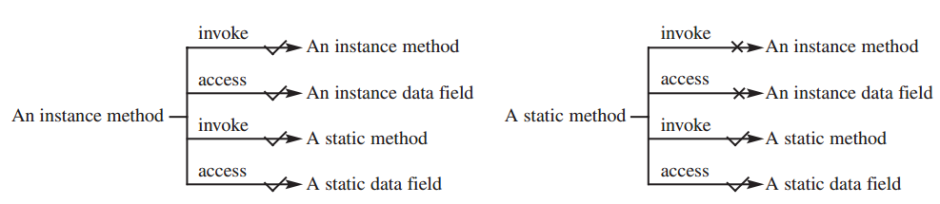
Instance vs. static
An instance method can invoke an instance or static method and access an instance or static data field.
A static method can invoke a static method and access a static data field. However, a static method cannot invoke an instance method or access an instance data field, since static methods and static data fields don’t belong to a particular object.
The relationship between static and instance members is summarized in the following diagram:

Slide 25
Let’s write a class with static members
Use Class Name to invoke a static method and to access a static variable. This improves readability, because other programmers can easily recognize the static method and data in the class.

